Slide 1
OBJECT ORIENTED PROGRAMMING with C++

Slide 2
Project Report
The name of our project is ‘KnowledgeKicks’.
It is a Quiz game application.
It was build using C++ and the SFML GUI library.
8/25/2023

Slide 3
OBJECTIVES
To learn and understand the application of object oriented programming using C++.
To develop problem solving skills.
To learn the basics of game development.
To build an attractive UI to interact with the users easily.
To learn to work and communicate with the team.
To be prepared to work on a major project in the coming years.
8/25/2023

Slide 4
The main function
Abstraction
An object of Game class is created and the member function of Game class
named ‘run’ is called
8/25/2023

Slide 5
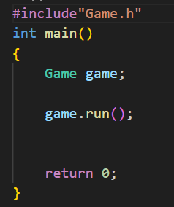

Slide 6
The Game Class
The game class is the engine of our software.
This class facilitates all the GUI events that takes place throughout the runtime.
The most important information to take away from the image is the stack named state.
8/25/2023

Slide 7
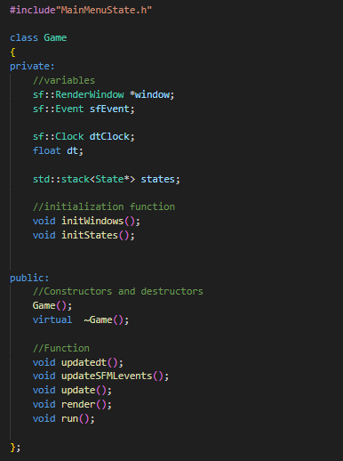

Slide 8
States
In the context of GUI software, a State is specific condition, situation of mode the software is on. As with most application, when the app is first opened, we are greeted by the Main Menu screen. Most major feature of the application are displayed in the Menu Screen.
And then by pressing a key or clicking a button we are moved into another ‘screen’ where different things are being displayed.
Each of the ‘screen’ with specific functionality are are called State.
8/25/2023

Slide 9
Stacks of State
We create a Stacks of state.
We can imagine the whole application as multiple States in a stack, and we are viewing the State at the top.
We can navigate through different States by pushing of popping the states from the stack.
8/25/2023

Slide 10
The State Class
This is an abstract class and most of it’s functions are virtual.
It has two data member, state and RenderWindow (sfml feature).
The actual States of our application are individual classes that inherit from
the State Class.
8/25/2023

Slide 11
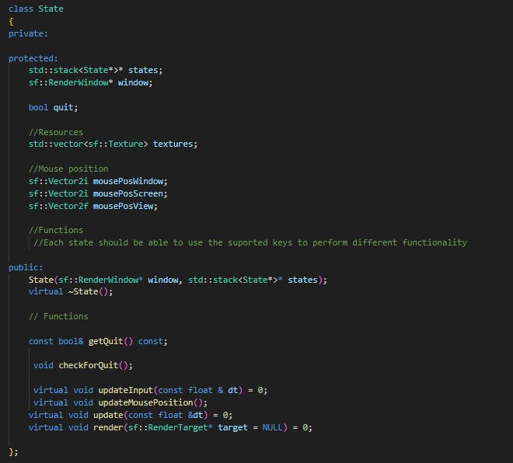

Slide 12
The Button Class
As the name suggest, this class helps to create clickable buttons in our
application.
We can update the button and know when the button has been clicked.
So, we can control the flow of the program using Buttons.
8/25/2023

Slide 13
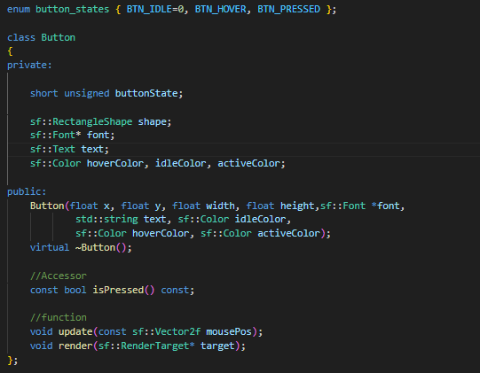

Slide 14
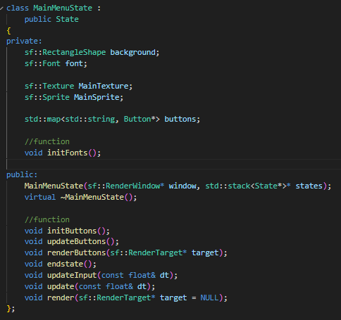
The MainMenu State
The MainMenu state is the state
that greets the user when the
Game is run.
8/25/2023

Slide 15

How to make the state appear?
In the Game.cpp file, we first initialize a state.
i.e. Create an object of a state and Push it in the stack of states.
Then in another function of the Game class, we then run the update
function of the object of state class on the top of the stack.
8/25/2023

Slide 16
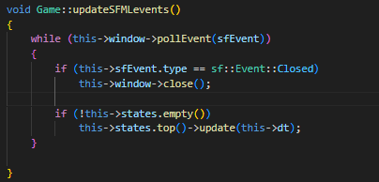

Slide 17
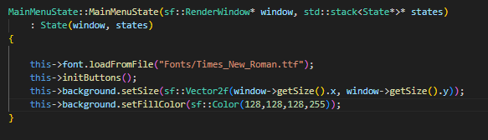
MainMenuState Constructor
When we create the MainMenuState object in the game.cpp file, the
constructor of the class is called and all the necessary components are
Initialized.
8/25/2023

Slide 18
Make state appear cont.
After the MainMenuState object has been pushed, the run function of the
Game class object is executed.
This function runs a loop which updates and renders the GUI component of
the State object on the top of the stack.
This way the state can appear in the screen.
8/25/2023

Slide 19
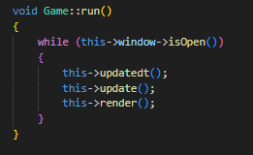

Slide 20
FlowChart
The next slide shows a flow chart explaining the process from start of the program to images or GUI being shown in the screen.
8/25/2023

Slide 21
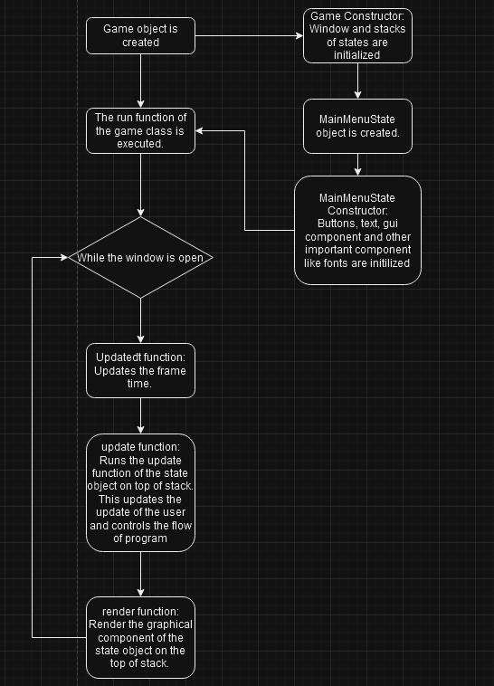
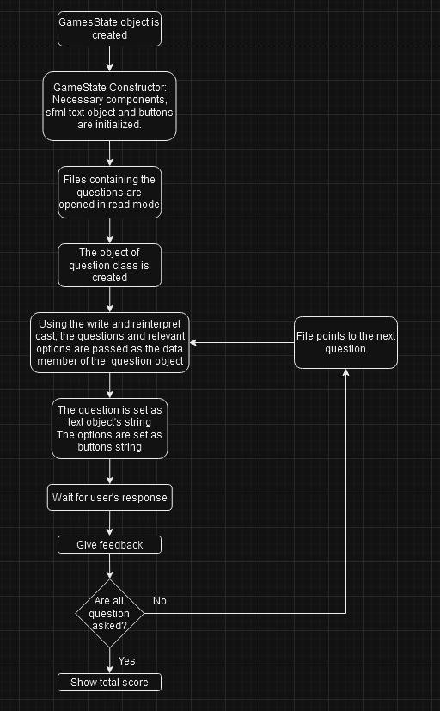

Slide 22
How is the questions asked?-the question state
The question state is used to create a random access file and store the question and other relevant data in the file.
An object of the Question State is created and the question is passed as the data member of the object. Then the object is written into the file.
When we need to read the question, we again create an object of the Question state and pass the data from the file as member of the object.
8/25/2023

Slide 23
Navigation
We can click different buttons in the Main Menu to select Genre, see the High Score and most importantly to play the game.
Buttons are primarily used for navigation, however keyboard keys like Escape can also be used to quit some states.
8/25/2023

Slide 24
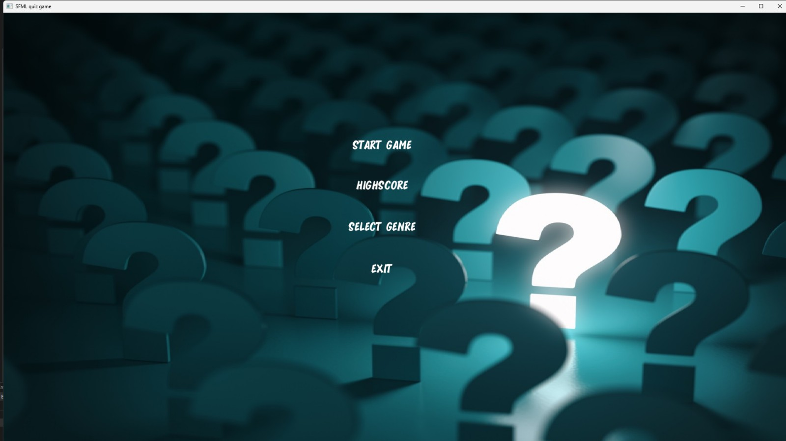
How the MainMenu State looks.
8/25/2023

Slide 25
How is Genre Selected.
On the GenreSelect state, depending on which button is clicked we save the path of the file containing relevant question in a file
named files.
On the gameState, we open the files file and extract the text written in the file and store it in a string variable.
Then we use the string to which stores the path of the file containing question, to open the file.
8/25/2023

Slide 26
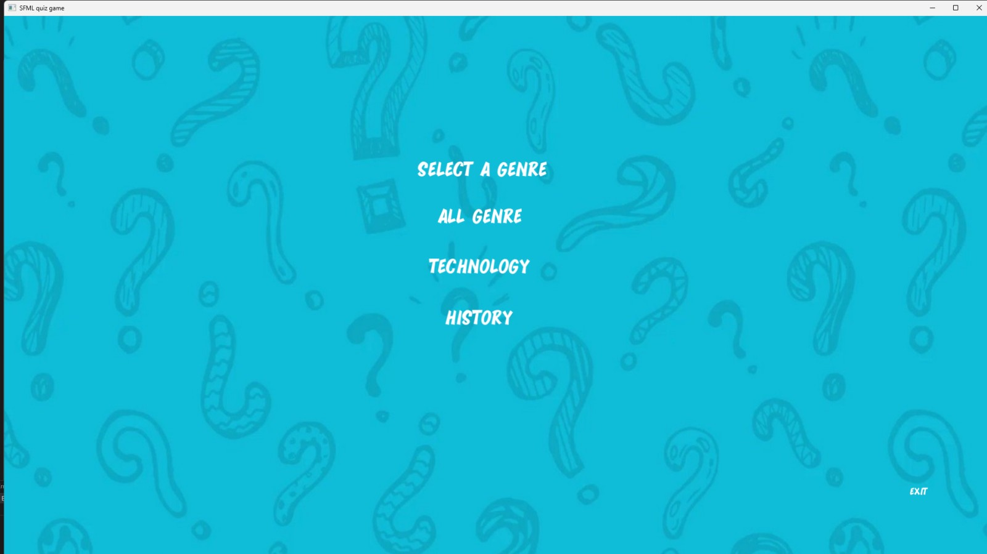
Selecting Genre
8/25/2023

Slide 27
Game state
Here we play the game.
The question and the relevant options are first stored as data member of an object. Then the object is written into the file.
We again extract the questions as data member of an object.
We then initialize question and the options.
8/25/2023

Slide 28
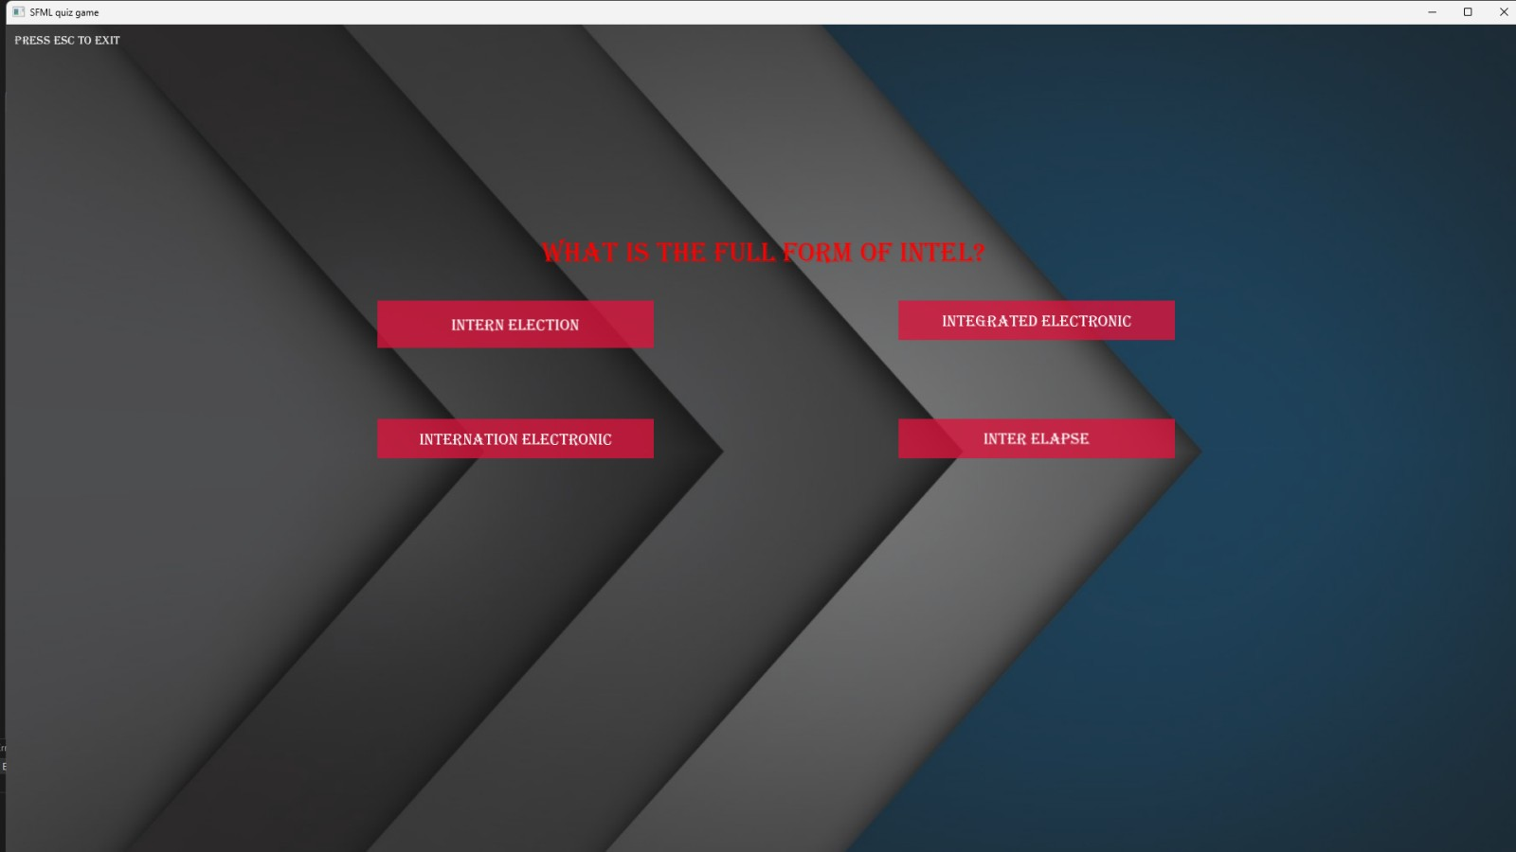
The Game State
8/25/2023

Slide 29
Feedback State
The feed back state tells whether you have clicked the correct option.
This compares the user option to the correct option specified.
We save the option entered by the user in a file and we compare it to the optioned specified.
8/25/2023

Slide 30
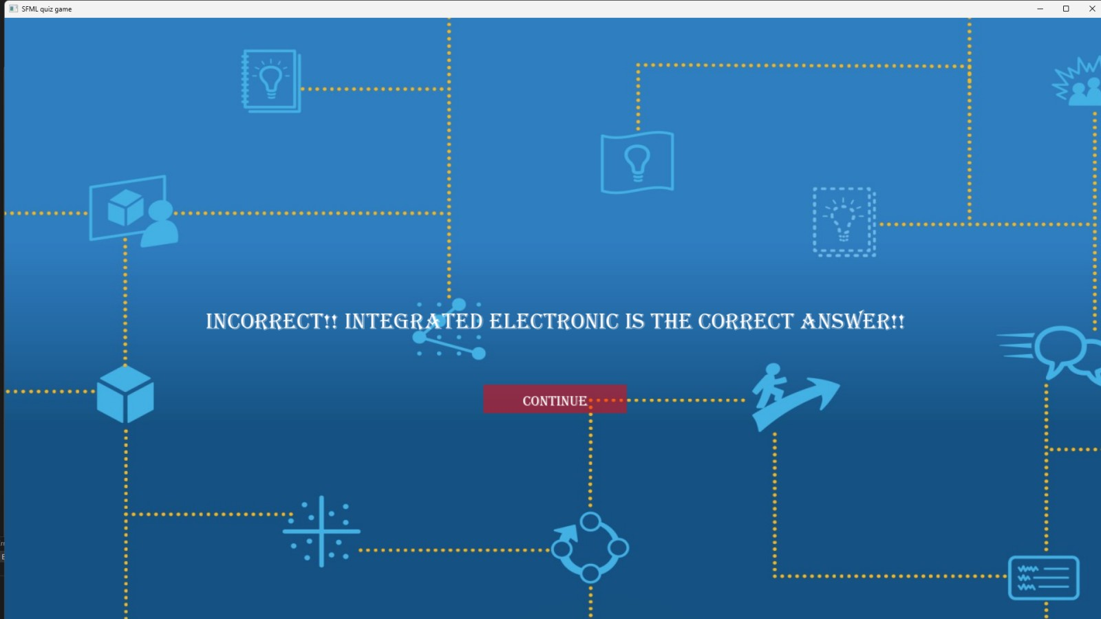
FeedBack State
8/25/2023

Slide 31
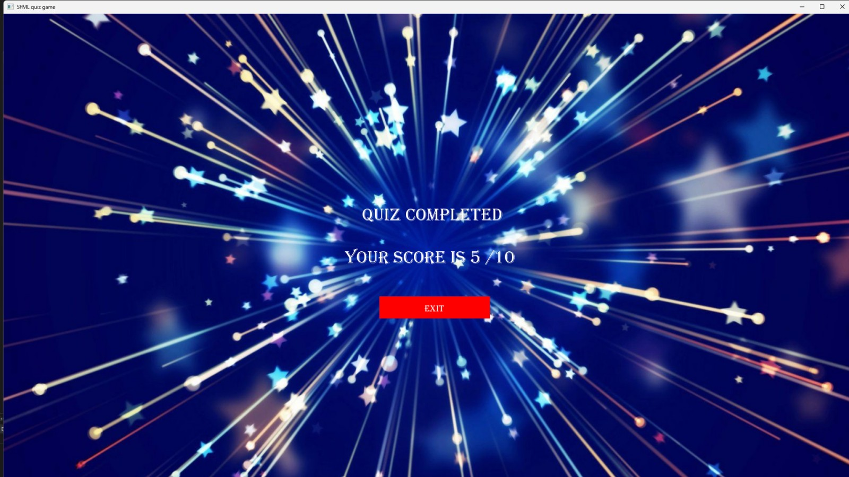
FinishState
Finish State simply displays the total points scored in the quiz session.
8/25/2023

Slide 32
The HighScore State
The HighScore state displays the Highest Scores scored in each genre.
After every question is answered, the record of how many questions were answered correctly is kept as score. At the end of the quiz, we then save the score into the file.
The score is then compared with the highscore. If the current score is higher, it is stored as the new highscore.
8/25/2023

Slide 33

HighScore State
8/25/2023

Slide 34
LIMITATIONS
The player cannot choose the difficulty level of the game.
No hints and lifeline features in expense to the coins collected to help the player.
No separate profile for each player so cannot record each player’s achievements.
No multiplayer mode to play 1 vs 1 or as a team online.
Lack of proper graphical interface.
8/25/2023

Slide 35
FUTURE ENHANCEMENTS
Implementing difficulty level helps the player to play the game according to their difficulty. This also challenges the player to improve their difficulty level.
Using the coin system that increases with the score helps in the use of hints and lifelines.
Multiplayer mode. This allows two or more players to team up and play against each other online via networking.
Use of attractive interfaces and animations could enhance the user experience.
8/25/2023

Slide 36
THANK YOU
BY:
-BHRAMAN SHRESTHA
-JANARDAN BHETWAL
8/25/2023

